Slide 1





DATABASE
MIGRATION
A software program for migrating databases across MySQL and PostgreSQL RDBMSs’
Abrahamyan Silvia
Arevshatyan Ani
Notes:
barev dzez es … es … mer projecty naxatesvac e tarber relacion databazaneri karavarman
hamakargeri mijev tvyalneri sxemaner texapoxelu hamar; arayjm menq irakanacnum enq
ayd gorcyntacy MySQL ev postgreSQL Rdbms.neri hamar

Slide 2
Contents
Introduction
How the program works
Software development process
Technologies used
The final product
Further development
Notes:
Nerkayacman yntacqum xoselu enq Databazaneri migraciayi anhrajeshtutyan depqeri,
katarman gorcyntaci, mer projectum xndri lucman tarberaki, ogtagorcvac texnologianeri
ev projecti zargacman puleri masin

Slide 3












Introduction
Notes:
hachax anhrajesht e linum poxanakel mec qanakutyamb tarber tvyalner.
Aydpisi anhrajeshtutyun ka hatkapes IT volortum
.. orinak
. ete kazmakerputyuny voroshuma poxel rdbms.n => hin bazayic tvyalnery petq e texapoxven nori mej
. orinak vichakagrakan (statistica) tvyalner havaqox kazmakerputyunnery kariq unen vercnelu tvyalner
tarber kazmakerputyunneri taratesak rdbms.neric
Ayspisi iravichakneri hamar anhrajesht e amboxjakan miasnakan hamakarg vory kiragorci bolor texapoxutyunnery:
Ays xndri lucman hamar henc mshakvel ev mshakvelu e ays proekty:
Arayjm naxagci naxnakan tarberakum irakanacvac en MySql ev Postgres rdbmsneri mijev poxadardz texapoxum;

Slide 4
How the program workS
PostgreSQL type schema
MySQL type schema
Tables Columns
Relations
Tables Columns
Relations
Convert
Selecting tables
Apply /implement
Analyze
Notes:
Inchpes e ashxatum hamakargy ogtagorcoxi koxmic tvyalneri bazayi masin nermucvac tvyalneric voroshvum en skzbnakan axbyur
handisacox ev npatakayin tvyalneri bazaneri tipery : Skzbnakan tvyalneri bazayi himan vra stexcvum
e tipin hamapatasxan sxema vorn ir mej nerarum e ayd tvyalneri bazayum gtnvox bolor axyusaknery dranc masin
texekutyunnery bolor syuneri tipery dranc vra drvac sahmanapakumnery ev axyusakneri mijev kapery :
Ogtagorcoxin hnaravorutyun e trvum yntrel ayn axjusaknery voronq petq e migraciayi entarkven,
katarvum e sxemayi poxakerpum npatakayin Rdbmsi tipi sxemayi: Dra himan vra npatakayin Rdbmsi
kanonnerin hamapatasxan generacvum en axjusakneri stexcman primary ev foreign keyeri texadrman
ev grancumneri avelacman sql harcumner

Slide 5






Software development process
Final step
Web Application
Fifth step
Fourth step
Third step
Console Application
Second step
First step
Final step:
Adding Websocket for dynamic acknowledgment about migartion process
Ability to work parallel
Fifth step:
Develop the project especially with html css javascript
Third step:
Generating migration SQL queries for destination database
Processing the migration
First step:
Researches in different RDBMSs’
Explore information schema’s structure
Second step:
Analyzing, creating and converting schemas from source databases
Fourth step:
Integrating to web environment
Creating controllers models and views
Notes:
6 Adding Websocket for dynamic acknowledgment about migartion process Ability to work parallel
5 Develop the project especially with html css javascript, ability to work
4 Integrating to web environment , Creating controllers models and views
3 Generating migration SQL queries for destination database and doing the migration process
2 Analyzing, creating and converting schemas from source databases
1 Researches in different RDBMSs’ , explore information schema’s structure
Arajin pulum katarvel en hetazotutyunner relacion tvyalneri bazaneri karavarman hamakargeri veraberyal ,
usumnasirvel en sxemayi aysinqn axyusakneri, dranum parunakvox tvyalneri tiperi trvac
sahmanapakumneri axyusakneri mijev kaperi masin texekatvutyan pahpanman dzevery metatvyalnery
2rd pulum hetazotutyunneri himan vra arden karoxanum einq tvyalnei bazayic verlucel ev stanal sxeman,
ogtagorcoxin hnaravorutyun tal yntrelu naxyntreli axjusaknery ev poxakerpel sxeman npatakayin tipi
3rd pulum arden dzevapoxvac npatakayin sxemayi himan vra generacvum ein tvyal databazayin
hamapatasxan sql harcumnery ev katarvum er bun migraciayi gorcyntacy
Ays ameny katarvum er Console applicationi mijocov : Hajord qayly handisacav web mijavayrin integrumy
4rd pulum stexcvecin Controllerner, voronq patasxanatu en qartezagrman(mappingi) hamar ev katarum
en tvyalneri poxanakman funkcian klienti ev serveri mijev, stexcvecin hamapatasxan tesqer(viewner)
voronq nerkayacnjum en klienti ogtagorcman interfacey, ev modelner voronq handisanum en tvyalneri
het ashxatanqi patasxanatunery aysinqn bun migracion gorcyntac kazmakerpoxnery
5rd pulum manramasn mshakvec client sidey html css javascriptov apahovvecin ogtagorcoxin
harmaravet tesq parz interface harcumneri katarman hamakarg ev ayln
Verjnakan pulum katarvecin uxxumner voronq hnaravorutyun tvecin ogtagorcel cragiry zugaher mi
qani ogtagorcoxi koxmic naev avelacvec eji dinamik tarmacum apahovox websocket vorn
apahovum e ogtagorcoxin gorcyntaci arajyntacii masin texekanalu hnaravorutyamb aysinqn cragri
Katarman yuraqanchyur qayli masin haxordagrutyun e stacvum dinamik rejimum

Slide 6
Technologies used
Server Side
Java
Spring Boot Framework
JDBC API
Client Side
HTML
CSS
JavaScript
JQuery
Ajax
Database
MySQL
PostgreSQL
…
Additional
Git
Maven
Notes:
Projecti stexcman hamar ogtagorcvel en hetevyal texnologianery
Serveri koxmi hamar ogtagorcvel e Java lezun nra mi qani Api(frameworkner) masnavorapes
Spring boot frameworky` projecty web mijavayr integrelu hamar, JDBC Apin, vory naxatesvac e
Sql lezvov harcumner grelu , tvyalneri bazaneri het kap hastatelu ev ashxatelu hamar:
Ogtagorcoxi koxmi hamar ogtagorcvel en Html css ev js skiptayin lezun, nra Jquery gradarany , ajax texnologian,
voroncov apahovvum e ogtagorcoxi interfacei tesqy parzutyuny harmaravetutyuny ev bazmafunkcional ashxatanqy
Tvyalneri bazaneri karavarman hamakargeric ogtagorcvel en Mysql postgresy bayc hetagayum naxatesvum
en ogtagorcvel naev ayl hamakarger inchpisin en Oracle, MS Sql, Maria Db.n ev ayln :D
Naev lracucich ashxatamnqy heshtacnelu ev ardyunavet dardznelu hamar ogtagorcvel e Maven Frameworky
vor naxatesvac e naxagci avtomat kompilaciayi karucman ev gorcarkman hamar:
Zugaher, bashxvac ashxatanq kazmakerpelu, cragrayin apahovman kodi popoxutyunnerin hetevelu npatakov
ogtagorcvel e git hamakargy : mer depqum skzbnakan pulerum cragiry bajanvel e yst tvyalneri bazayi tipi,
web mijavayr ancneluc heto bajanvel enq ashxatanqy yst funkcionalutyan:

Slide 7
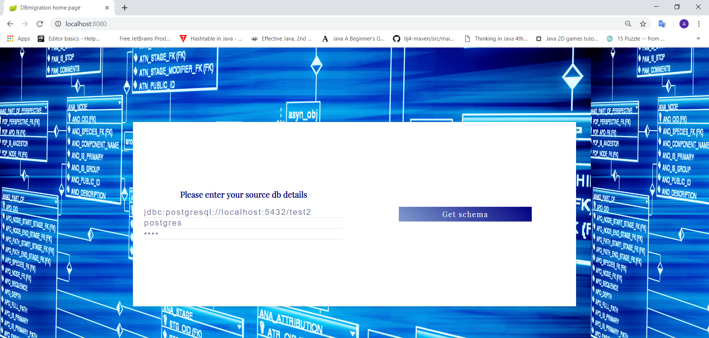
The final product First PAge
Notes:
Cragiry sksvelun pes ogtagorcoxy tesnum e mutqagrman dzev(forma ) vortex petq e
mutqagri axbjur handisacox tvyalneri bazayi het kap hastatelu hamar jdbc url username ev password aynuhetev
sexmelov Get schema kochaky ancnum e hajord ej
vorum```````````````

Slide 8
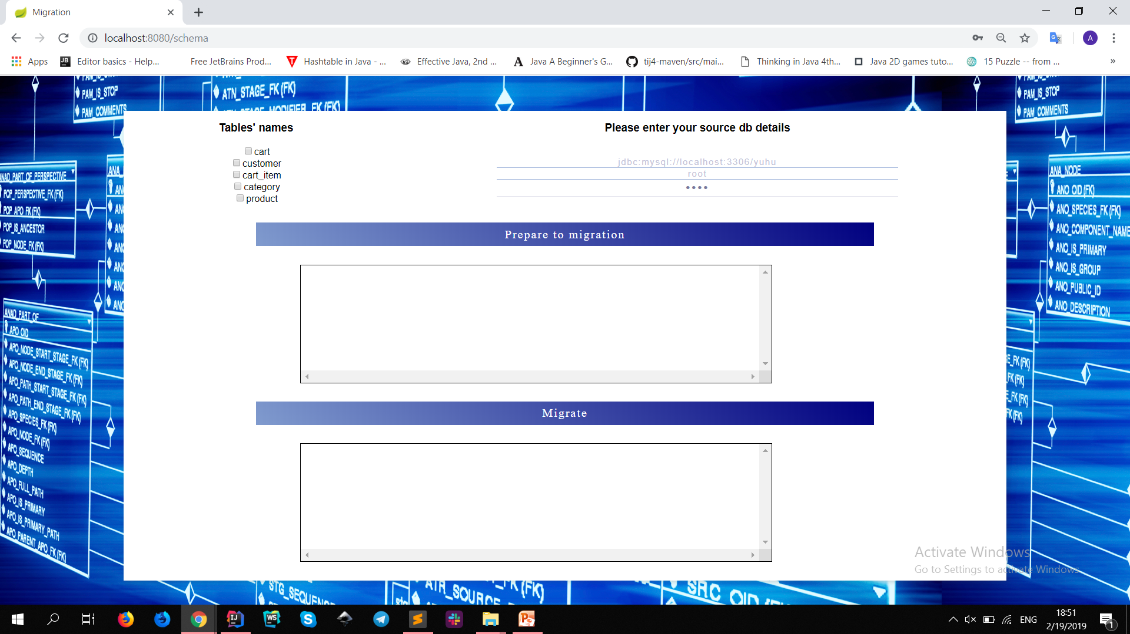
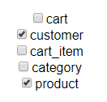
Main WorkIng Page
Notes:
Vorum``````````````
Ogtagorcoxy tesnum e source(axbyur) tvaylneri bazayi axyusaknery, voroncic karox e yntrel ayn
axyusaknery voronq cankanum e texapoxel destination(npatakayin) tvyalneri baza …. Npatakayin
tvyalneri bazayi masin texekutyunnery mutqagrvum en axyusakneri yntrelu het miasin vorpeszi cragiry
Voroshi RDBMS.neri tipery ev yntri hamapatasxan poxakerpman dasery:
Ays gorcoxutyunny kareli e katarel bazmaki angam qani vor cragiry apahovum e nuyn
tvyalneri bazayic tarber bazaner tarber sxemaner texapoxelu hnaravorutyun ..
Prepare to migration kochaki sexmumic skizb e drvum verlucman convertaciayi Sql harcumneri
generacman gorcyntac.. Nax anjatvum en Prepare to migration ev migrate kochaknery minch
preparation(naxapatrastman) puli avarty, apa jnjvum e minch ayd katarvac gorcoxutyunneri ardyunqnery ev
amen inch sksvum e noric :

Slide 9
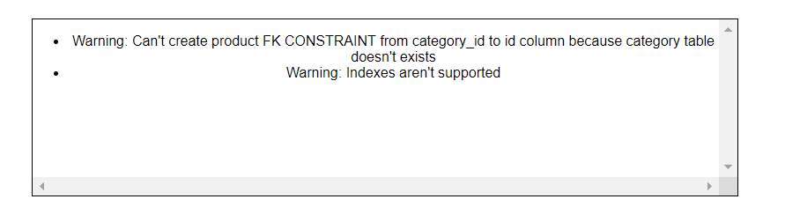

Preparation Process : Warning Messages
Notes:
Preparation(patrastman ) pulum katarvum e eji dinamik bernum .. Sqlneri generacman
pulum ogtagorcoxi axjusakneri yntrutyunic kaxvac karox en arajanal depqer erb
axjusaki mi syunaky hxvum e mek ay axjusaki vory yntrvac che nor sxema texapoxelu
hamar aydpisi zgushacumnery texekacvum en ogtagorcoxin dinamik websocketi mijocov
.. Vory handisanum e erkkoxmani kapi protokol(ardzanagrutyun) TCP- miacman himan vra `
naxatesvac browseri ev web serveri mijev irakan rejimum haxodagrutyunner poxanakelu hamar:
Naev ogtagorcoxy texekanum e unsupported featureneri(cragri koxmic derevs chirakanacvac funkcianeri) masin
Naxapatrastman puly avartveluc heto kochaknery veradardzvum en aktiv rejim ev kareli e arden katarel bun migraciayi gorcyntacy
(inchvor path vorin lsum en frontic isk serveric et pathin messagener en uxarkvum fronty eventhandleri nman erb eventa (message)a galis mshakum e ev arfdyunqy aranc ejy tarmacnelu patkerum e ejum)

Slide 10
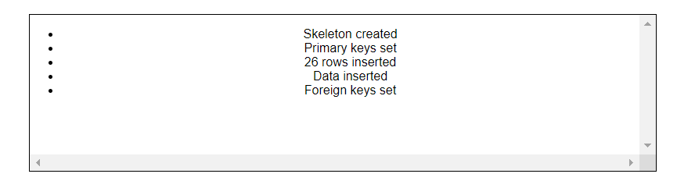

Migration : process Messages
Notes:
Naxapatrastman pulic heto Migrate kochakov sksvum e bun migraciayi gorcyntacy ,
vori yntacqum evs anjatvum en kochaknery, ays depqum websockety ogtagorcvum
e migarciayi gorcyntaci puleri masin texekutyunner haxordelu hamar .. Orinak erb
stexcvum e axyusakneri kmaxqy dashterin trvum en sahmanapakumner veragrvum
en default(lrelyayn ) arjeqnery ete dranq kan, drvum en primary key.ery , texapoxvum
en tvyalknery , dranc qanaki, foreign keyeri texadrman ev hajoxutyamb avartvelu masin haxordagrutyun

Slide 11

PostgreSql url jdbc:postgresql://localhost:5432/test2
MySql url jdbc:mysql://localhost:3306/yuhu
Notes:
Demoyi jamanak
Cucadrvum en source u destination db.neri sxemanery inteliji mejic vor meky liqna myusy datark
Ashxatacnum enq, nermucum tvyalnery , cucadrum checkboxeri mi qani angam tarber axyusakner
yntrelu hnaravorutyuny websocketi ashxatanqy ev verjacneluc heto db.neri vichaky migraciayic heto
Yntacqum kareli e sout anel sql harcumnery u cucadrel sql kodery voch manramasn

Slide 12
Further development
Support other RDBMSs
Oracle
MS SQL
...
Migrate
Views
Indexes
Functions
Sequences
Procedures
Triggers
Queues
Optimize migration
In case of referenced table does not exist do not migrate foreign key column
Notes:
Projecty(hamakargi, naxgci :D) nerka pahin irakanacnum e bun migracion gorcyntacy aranc
havelyal hnaravorutyunneri… apagayum naxatesvum e avelacnel ogtagorcvox RDBMS.neri
tiperi qanaky orinak Oracle Ms SQL Rdbms.nery , katarel naev tvyalneri bazayi ayl baxadrichneri
migracia ` masnavorapes view.ner proceduraner indexner trigerner ev ayln, ev vorpes havelyal
optimalacum chtexapoxel axyusakneri ayn syunaknery voronq hxvum en ogtagorcoxi koxmic chyntrvac axyusaki vra

Slide 13

Questions/Comments?
Notes:
Thank you. next! :D

